Slide 1
Exception
Day 1

Slide 2
Exception
Abnormal condition which occurs during run time and disrupts the normal flow of the program.
If this exception is not handled properly,
program will not be executed.
Hence, causing the abrupt termination of the program.

Slide 3
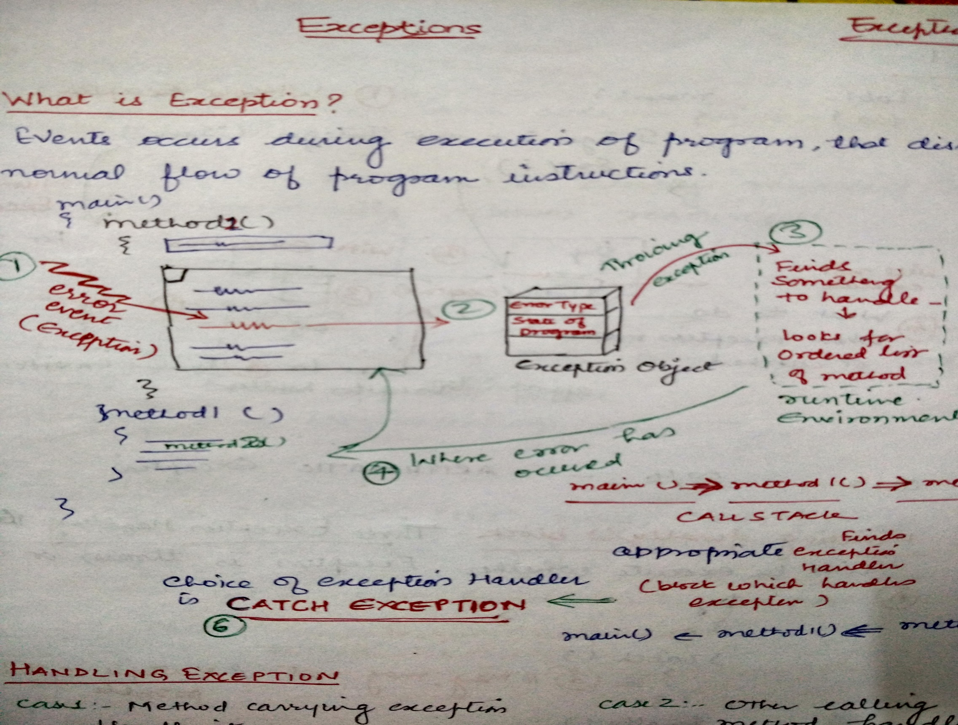

Slide 4
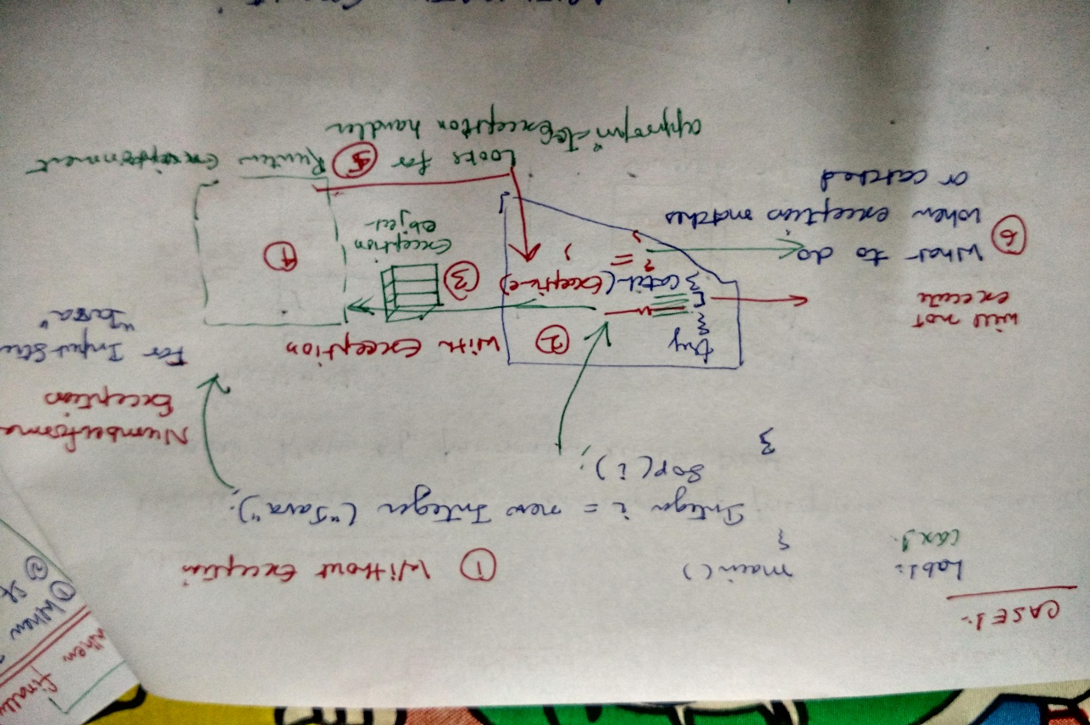
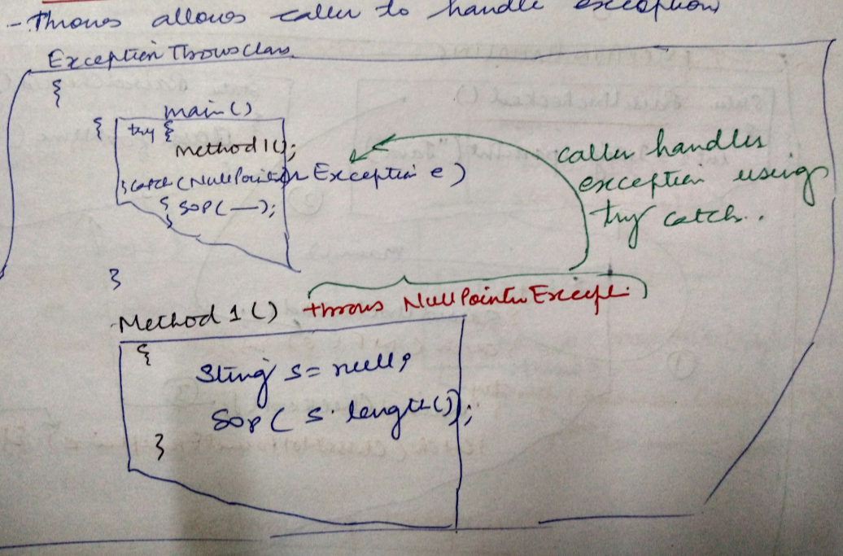
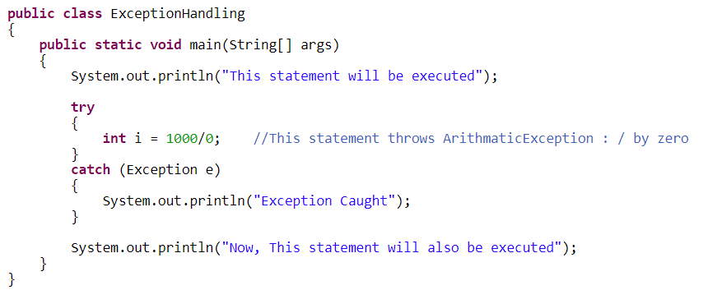
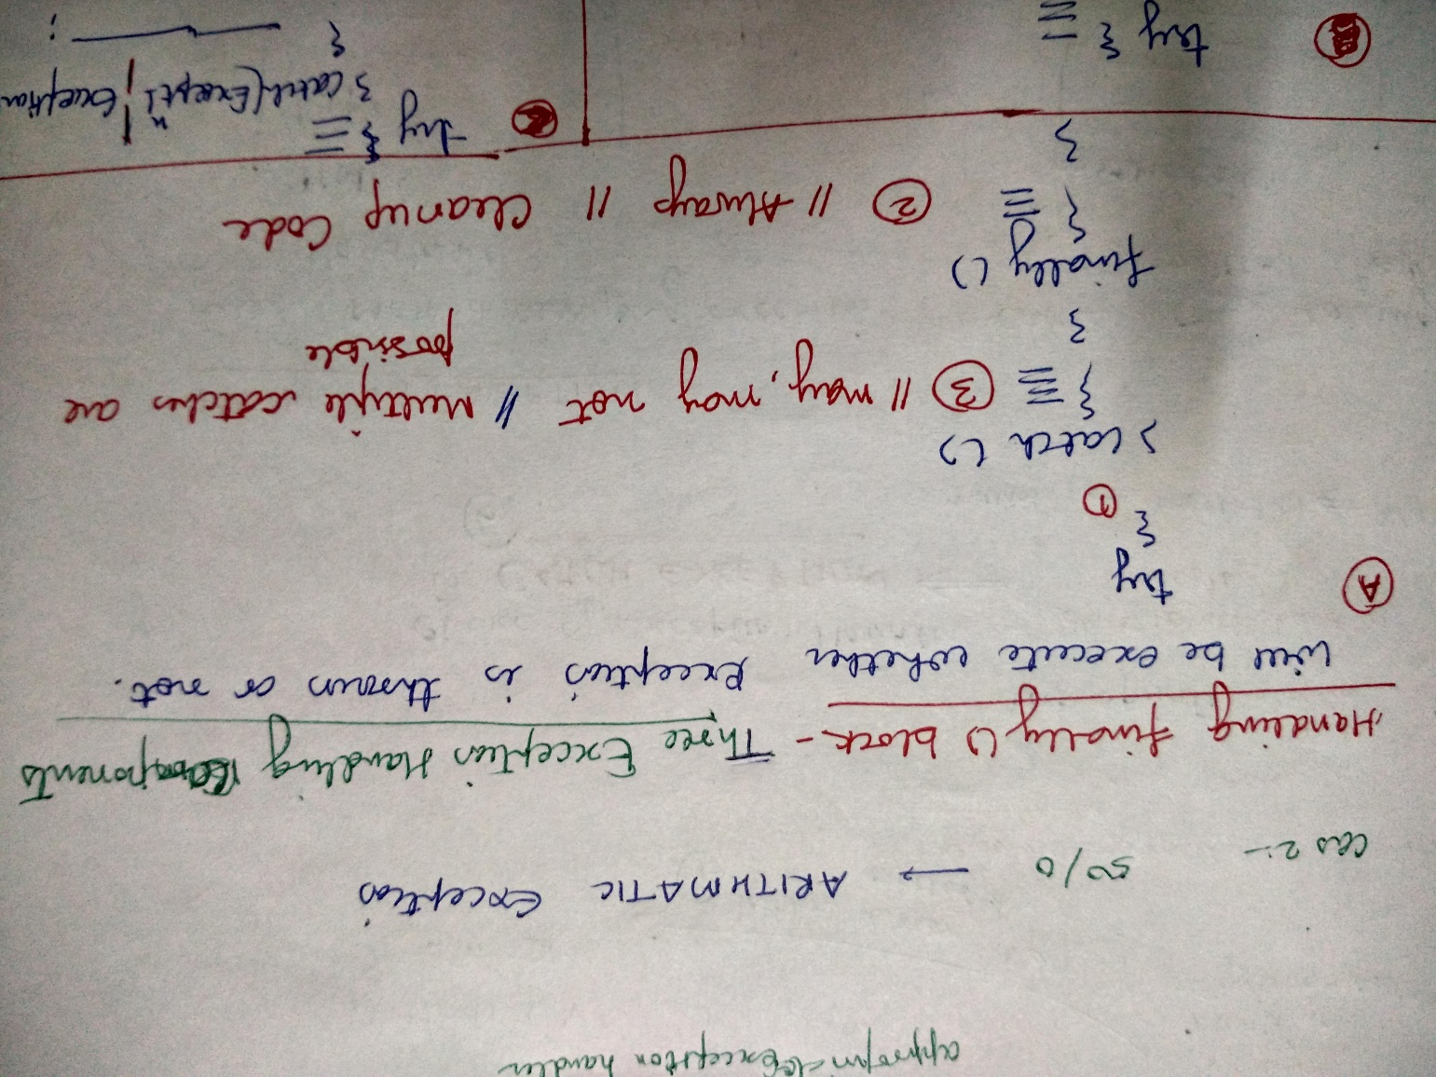
Case 1: Try…Catch Case 2: throws

Slide 5
Inside Method: Arithmatic Exception

Slide 6
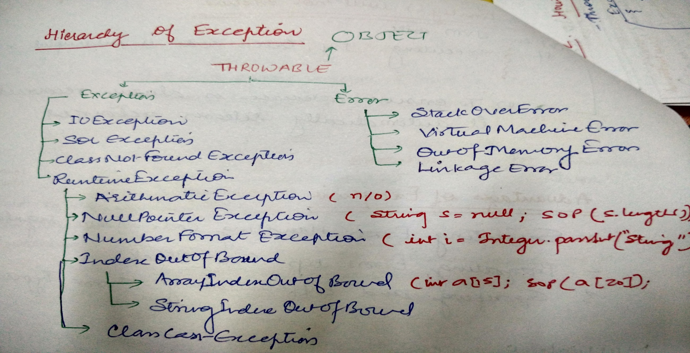
Exception API

Slide 7
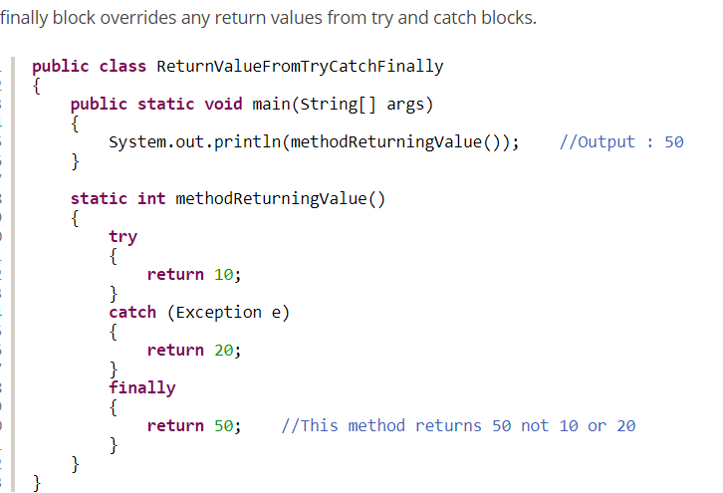
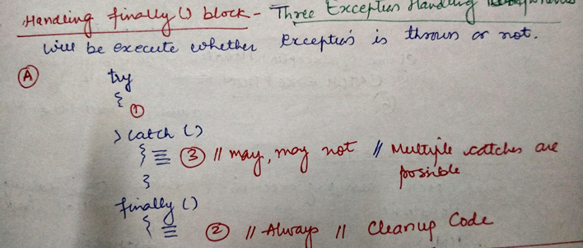
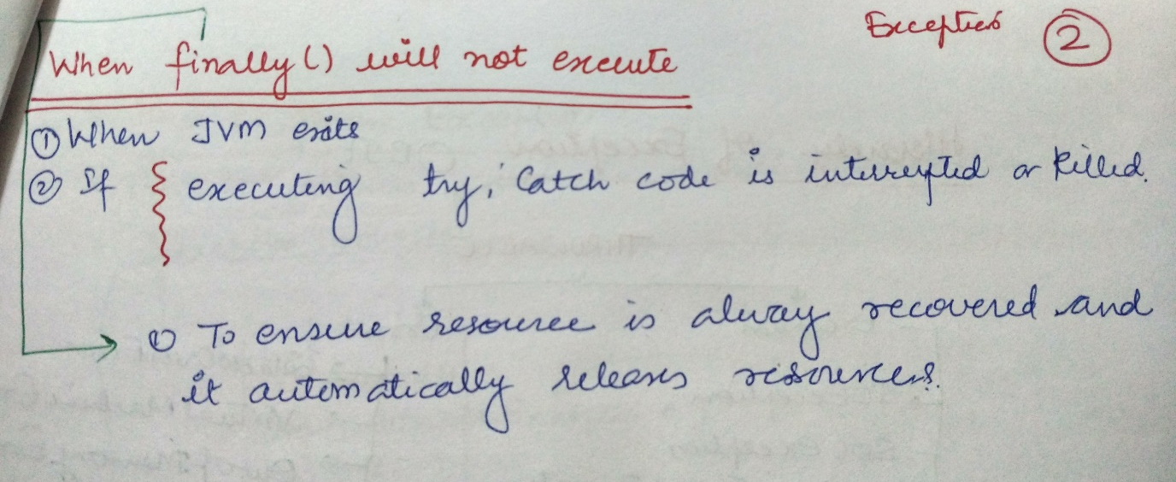
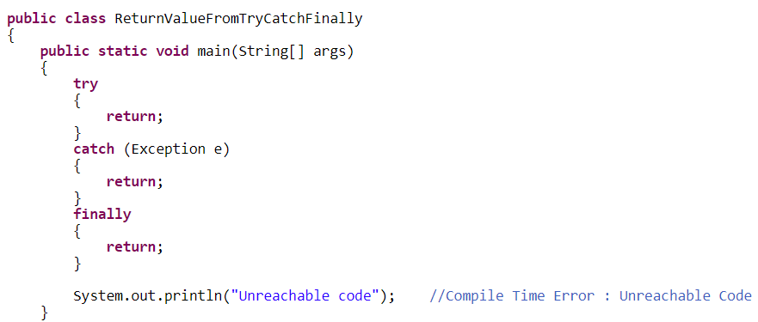
Finally Block

Slide 8
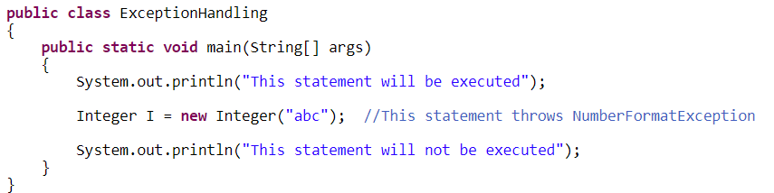
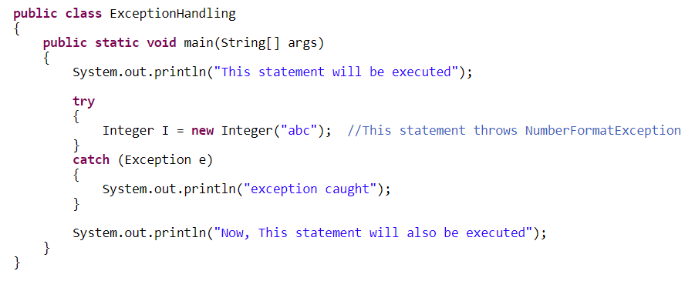
NumberFormat Exception

Slide 9
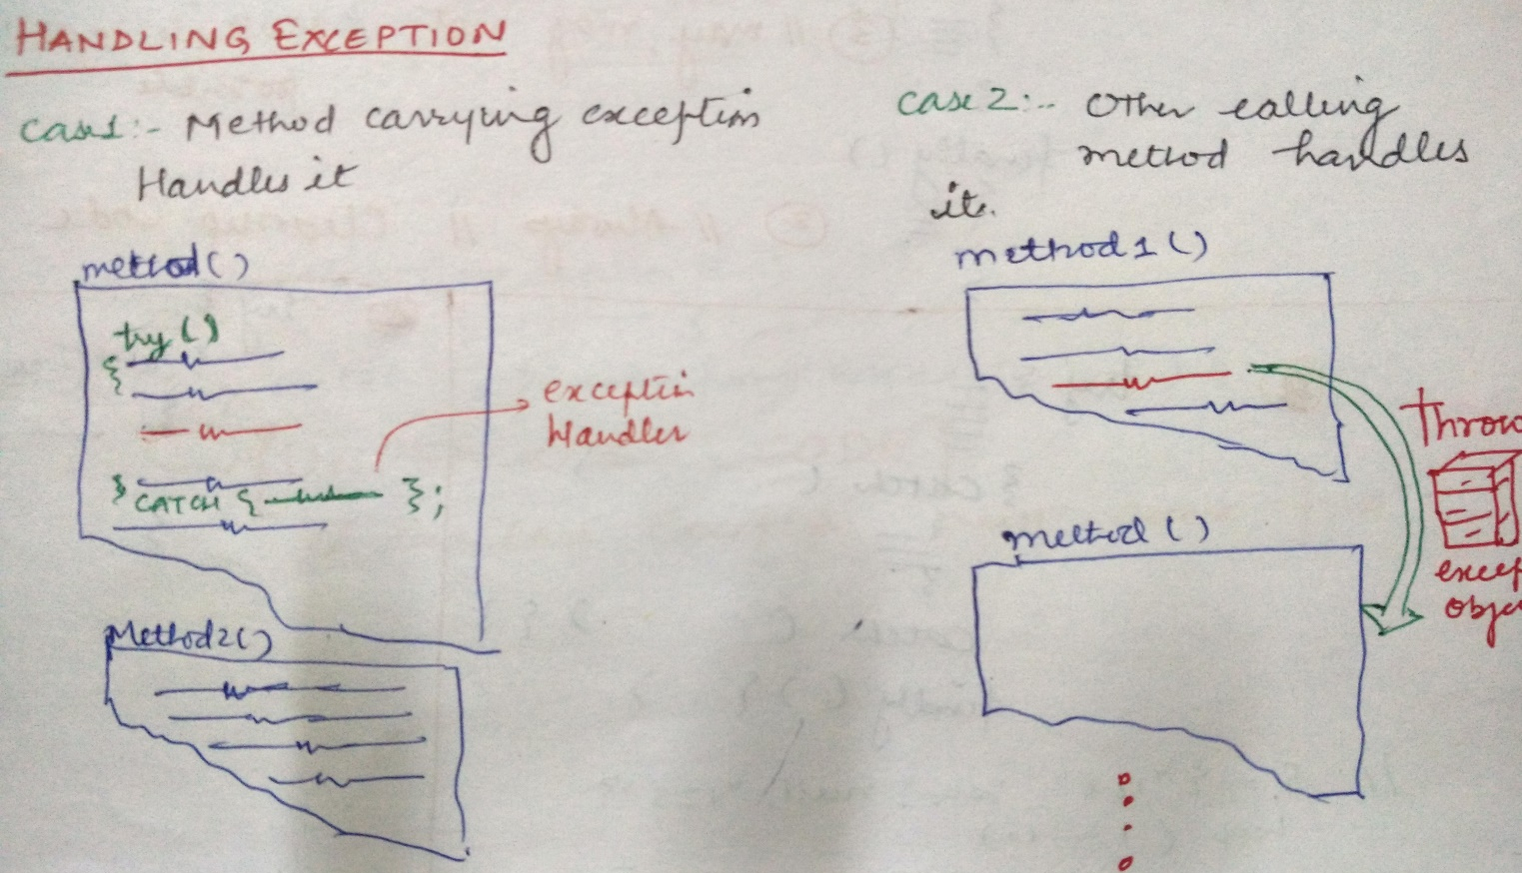
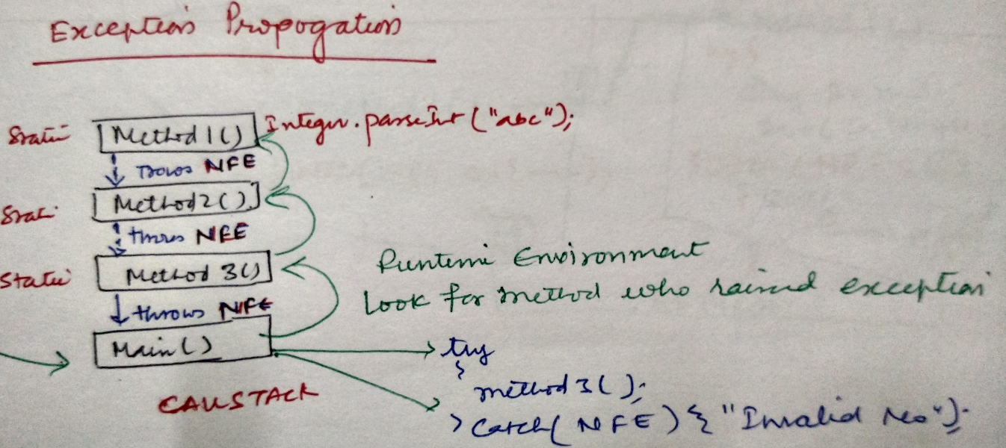
Handle Exception in Method

Slide 10
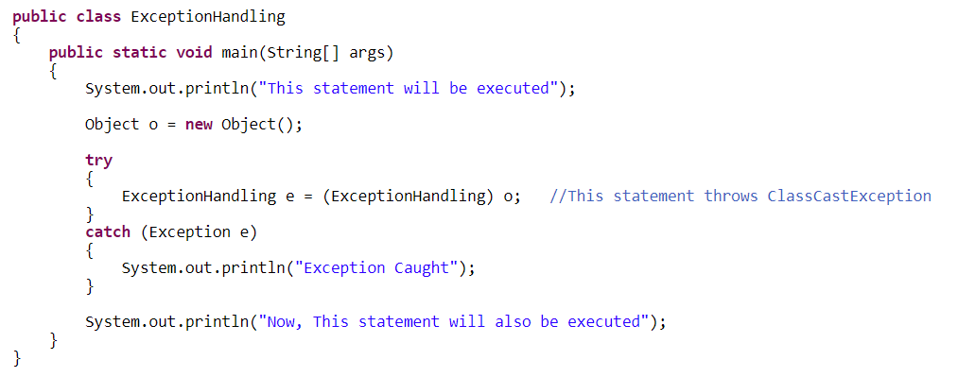
ClassCast Exception

Slide 11
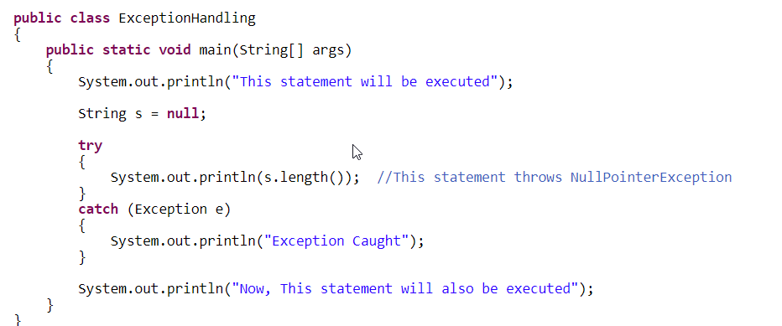
NullPointer Exception

Slide 12
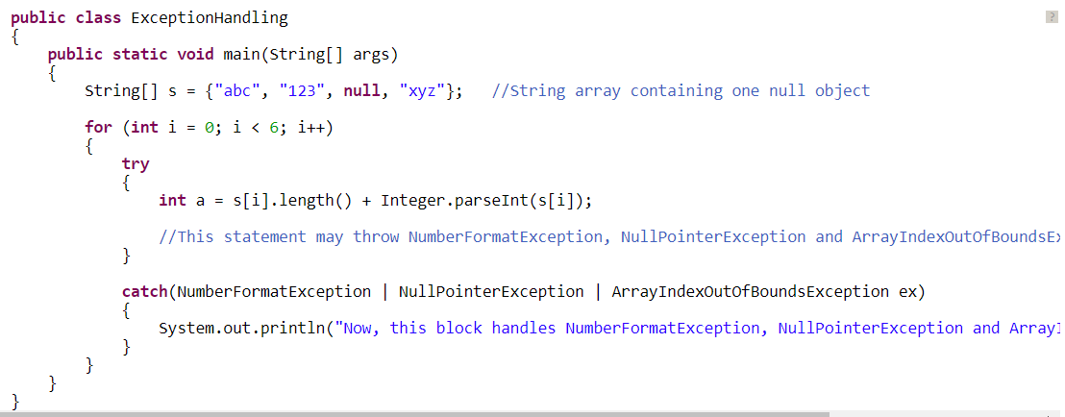
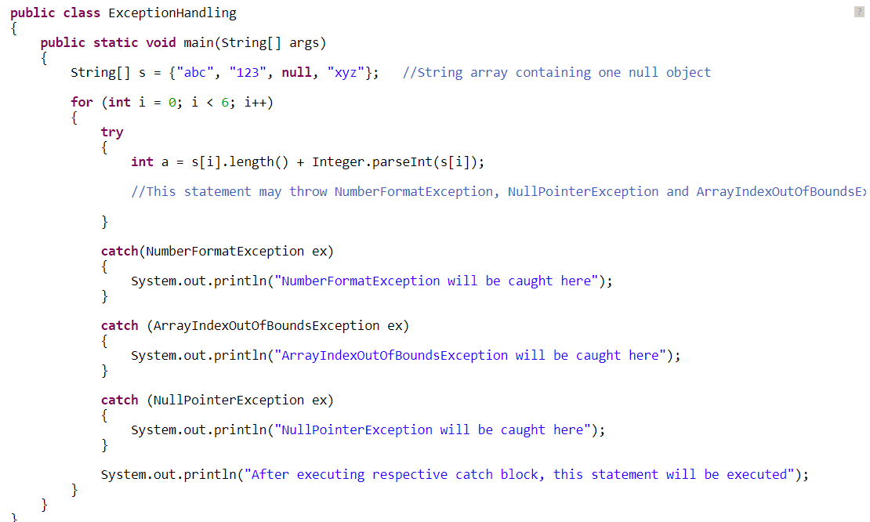
Multiple Exception
From Java 7-

Slide 13
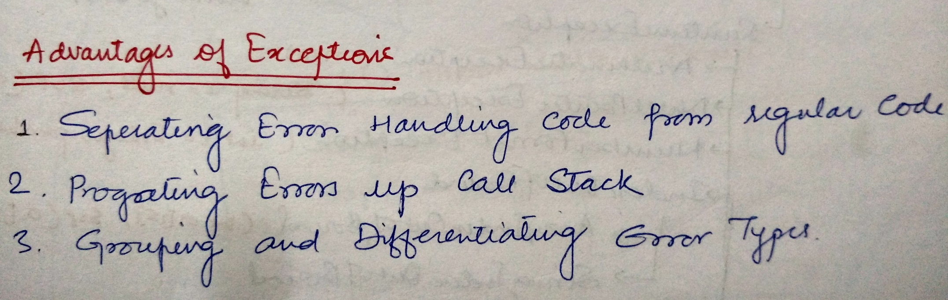
Advantages of Exception

Slide 14
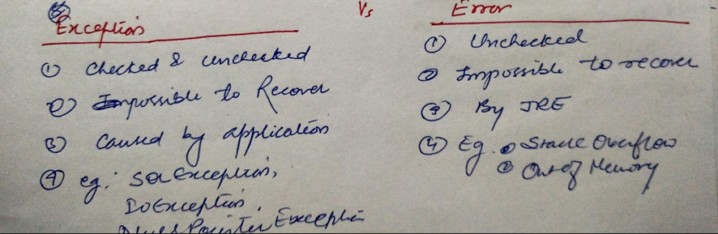
Error Vs Exception

Slide 15
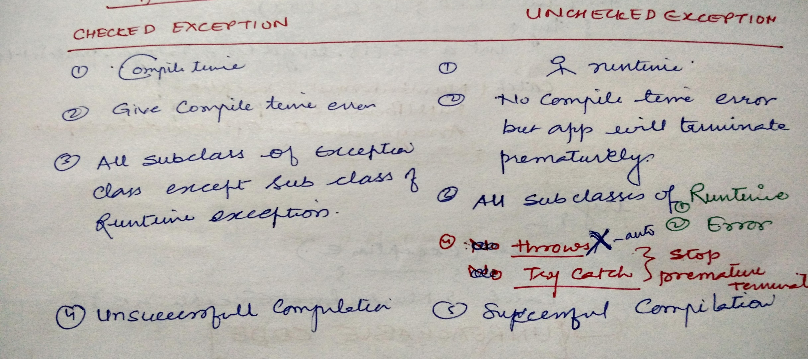
Types of Exception

Slide 16
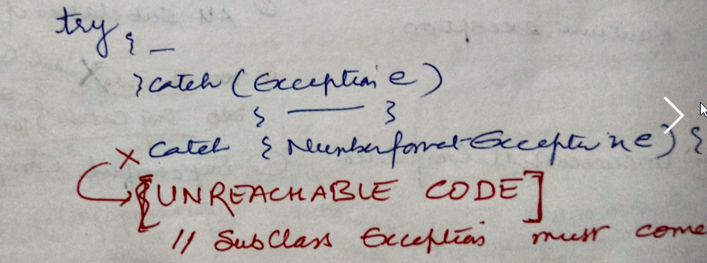
Unreachable Code

Slide 17
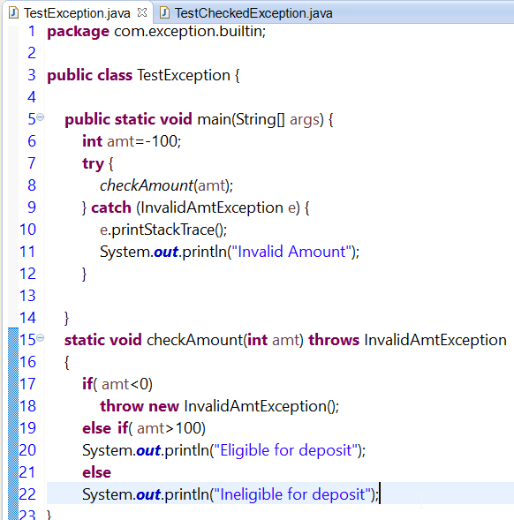
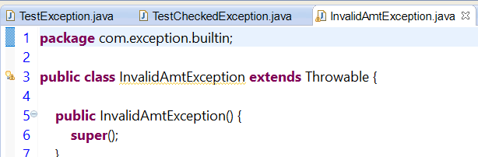
UserDefined Exception

Slide 18
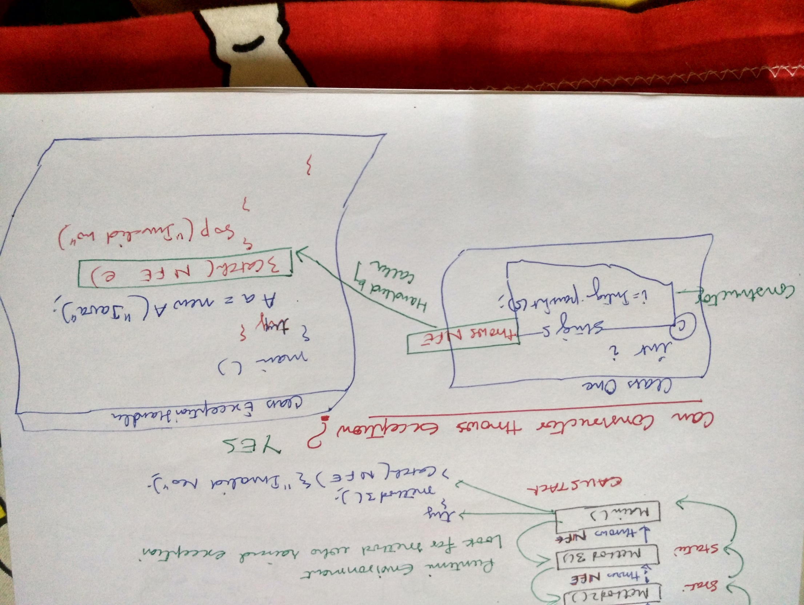
Exception in Constructor

Slide 19
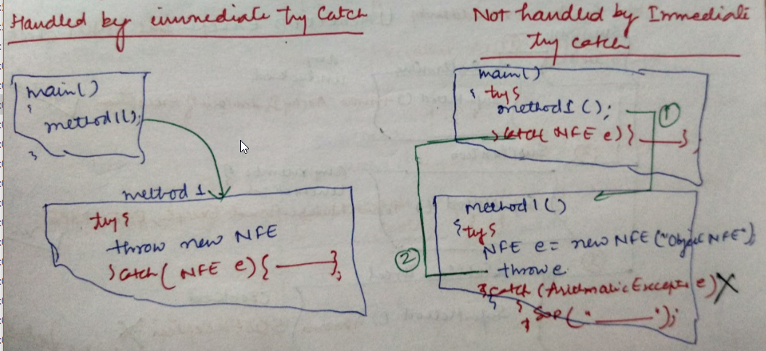
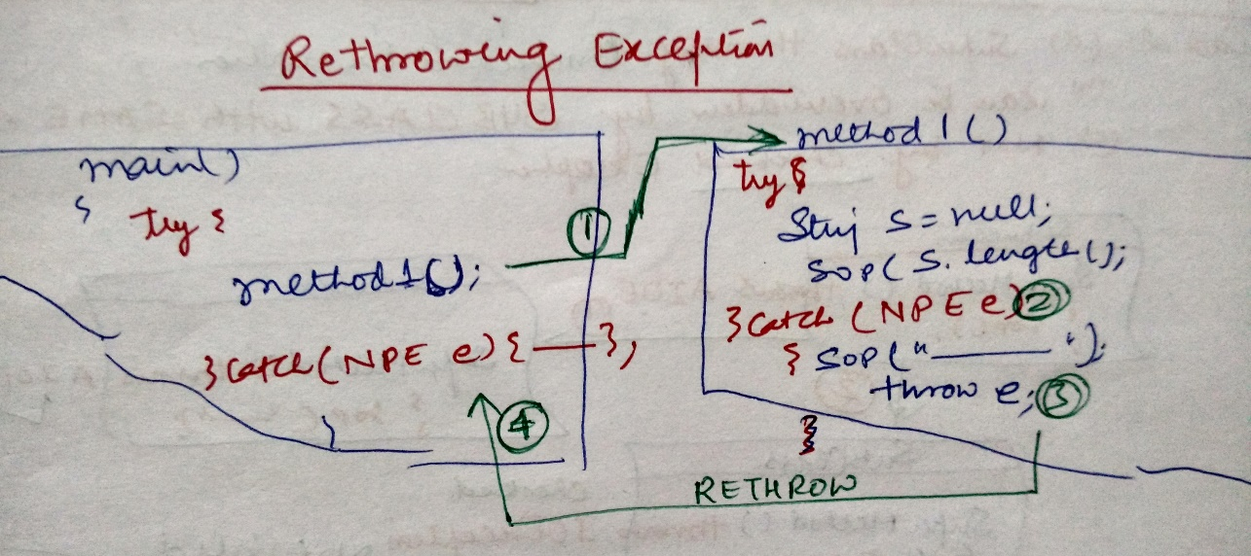
Explicitly Throw and Rethrow an Exception

Slide 20
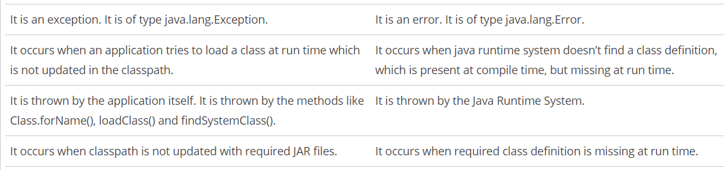
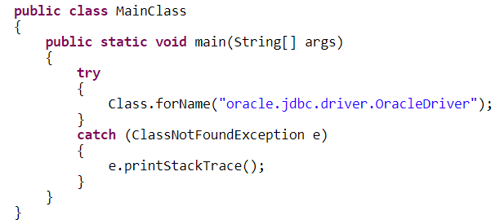
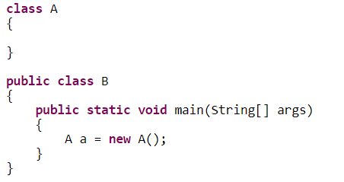
ClassNotFound Vs NoClassDefFoundError
When you compile the above program, two .class files will be generated. One is A.class and another one is B.class. If you remove the A.classfile and run the B.class file, Java Runtime System will throw NoClassDefFoundError like below,

Slide 21
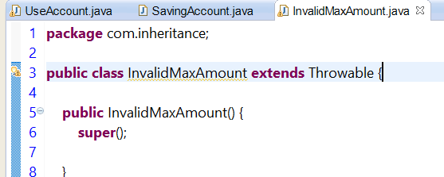
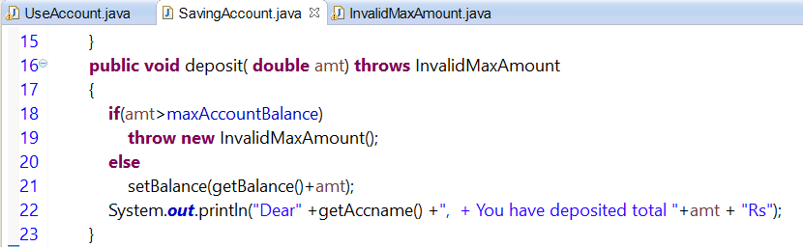
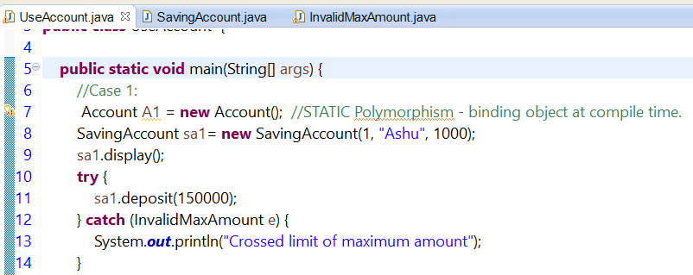
UDF - Account
Can yu create user defined RuntimeException

Slide 22
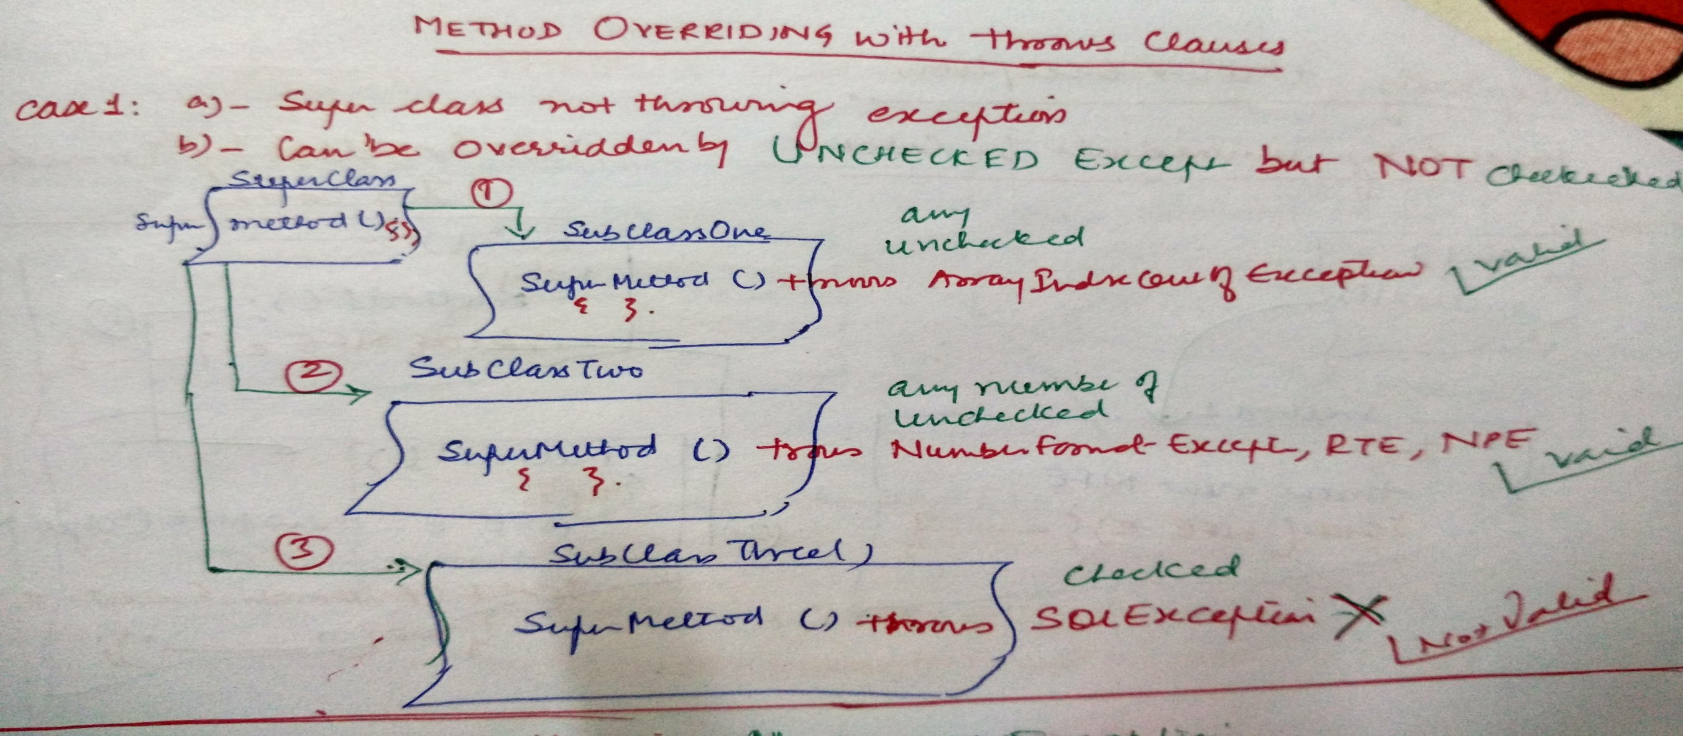
Method Overriding and Exception Case 1: Superclass with No Exception

Slide 23
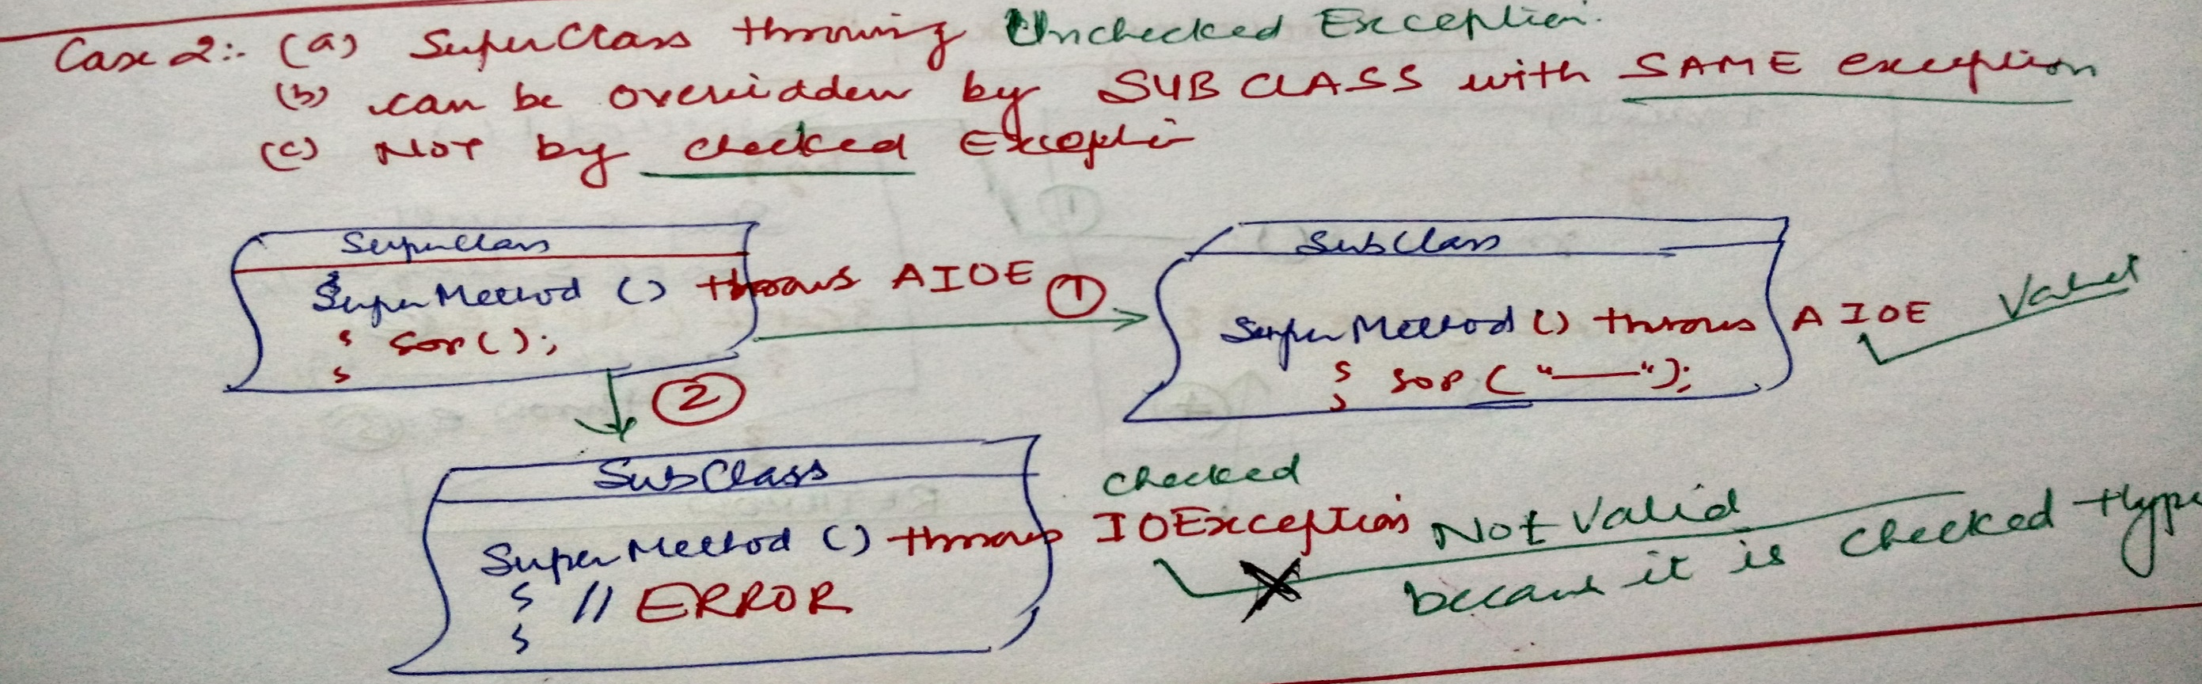
Method Overriding and Exception Case 2: Superclass throws an Unchecked Exception

Slide 24
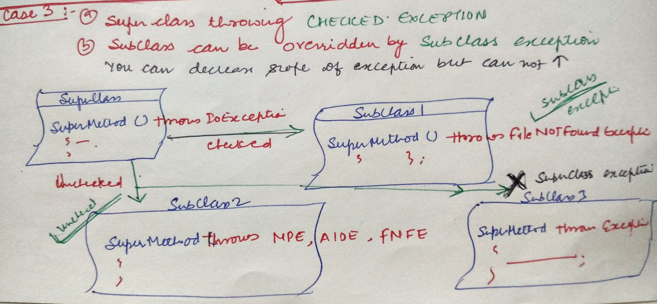
Method Overriding and Exception Case 3: Superclass throws an CheckException

Slide 25
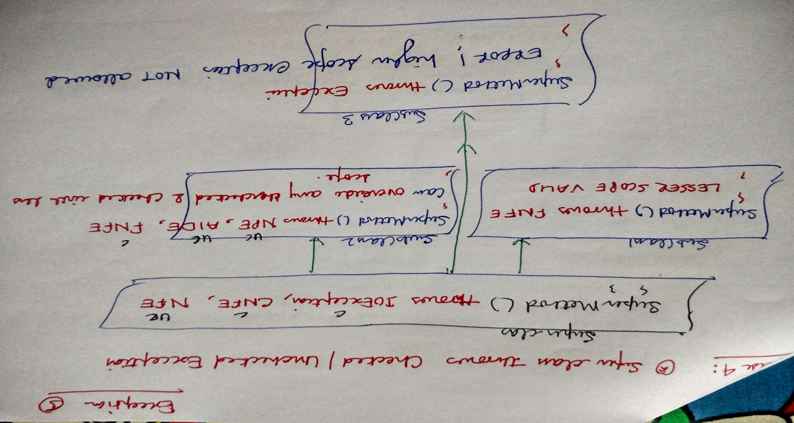
Method Overriding and Exception Case 4: Superclass throws an CheckExceptionUnCheckedException

Slide 26
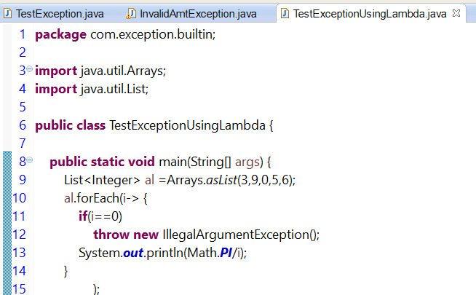
Lambda Expression - Exception

